Slide 1
Report: Interview with Library Administrator
LIS 650- March 3, 2009

Slide 2
Introduction
Interview subject
Interview location
Stakeholders

Slide 3
Introduction
Subject: Associate Director of Collection Services for the Professional Center Library (PCL) at Wake Forest University
Direct reports from four people
More than twenty-five years experience

Slide 4
Introduction
PCL is one of two libraries on Reynolda Campus of Wake Forest
Serves two professional schools: law and business
Relationship of “peaceful coexistence”

Slide 5
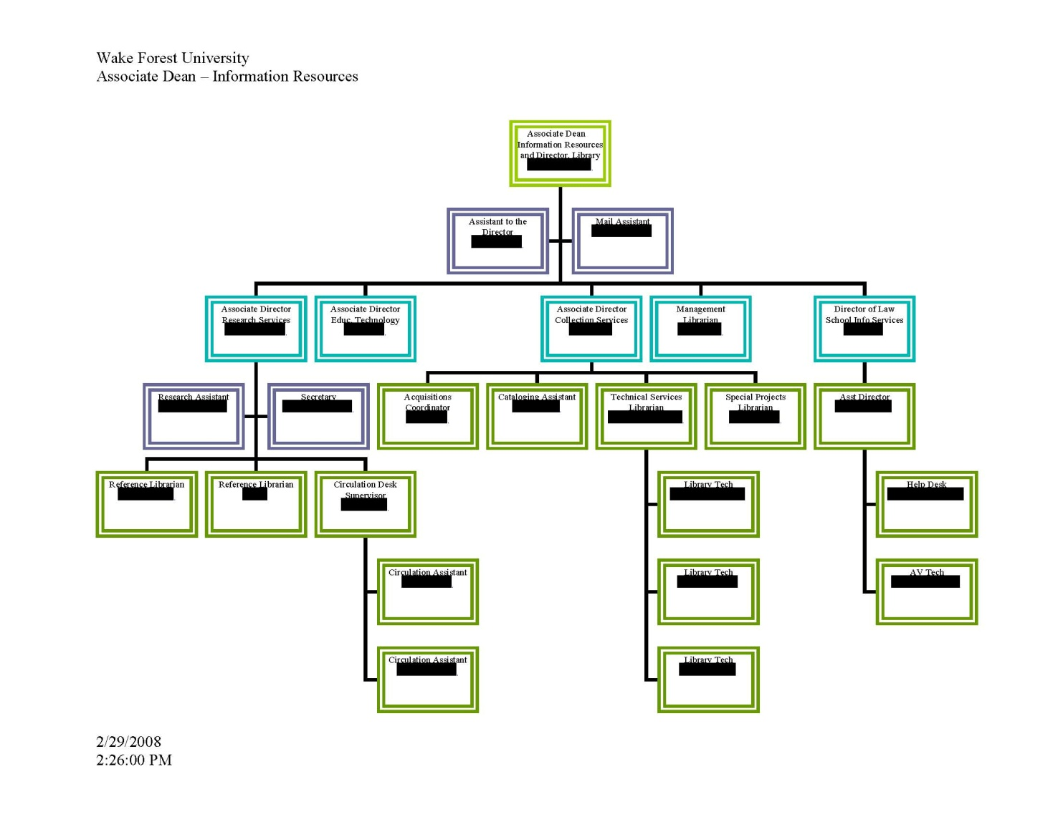
Introduction

Slide 6
Introduction
Primary stakeholders
  Faculty
  Students
  Staff and other patrons

Slide 7
Administrator Tasks
Three primary tasks
One-Third Rule
Percentage breakdown
Leadership and management

Slide 8
Administrator Tasks
Three primary tasks
  Systems Librarian
  Head of Technical Services functions
  Answers questions regarding facilities

Slide 9
Administrator Tasks
One Third Rule
  Management not part of curriculum while in library school, but learned about techniques later
  Does agree with the rule
  Most staff issues have been delegated to others
  Serves advisory role and sees to staff needs when necessary

Slide 10
Administrator Tasks
Daily breakdown of percentages
  Unable to do accurately, since most of work is project-based
  Serves as problem-solving agent
  Retains responsibilities of system administration and invoice authorization

Slide 11
Administrator Tasks
Definitions of leadership and management
  Being a good leader is being a good manager
  Good leaders inspire their followers to follow a vision, and management gets the job done with big picture in mind
  Metaphor of a building with leaders, managers and employees
  Team approach

Slide 12
Opportunities for Improvement
Vision for PCL
Goals for PCL
Traits of effective administrator

Slide 13
Opportunities for Improvement
Vision for PCL in terms of Collection Services
  “Better stewards” of money in era of declining resources
  Acquiring a library catalog with improved integration of e-resources

Slide 14
Opportunities for Improvement
Goals for PCL
  Being met “for the most part”
  Issues are staff training and staff priorities
  Can be complicated by staff turnover and outstanding projects

Slide 15
Opportunities for Improvement
Traits of effective administrator
  Creativity
  Openness
  Resist status quo
  Flexibility
  Constructive criticism
  Recognize good ideas

Slide 16
Opportunities for Improvement
Lessons to pass along
  “Learn the theory, and learn it cold”
  One can’t know it all, but one should know how to find it when needed
  Be willing to experiment and try new things
  Love what you do and keep doing it

Slide 17
Compare and Contrast Our Readings with Administrator
Three Secrets of Raving Fans
Twelve Questions from FBATR
Emotional intelligence

Slide 18
Compare and Contrast
Three Secrets from Raving Fans
  First Secret: wants his department to provide the best materials that resources will allow
  Second Secret: find out what the three patron groups want
  Third Secret: improve services whenever possible

Slide 19
Compare and Contrast
Twelve Questions from FBATR
  Yes to all questions except:
    Question 2: Yes for basic needs, but the answer could be no depending upon budgetary constraints.
    Question 8: Not a conscious decision for his work, since it is process-driven
    Question 10: Not necessary, more important to know if one can work well with others.

Slide 20
Compare and Contrast
Emotional intelligence
  Managed different types of people during career
  Feels a good manager can manage the differences between individuals
  In team environment, everyone can be viewed the same way, but personal chemistry can be factor
  Objective: how to handle the job at hand

Slide 21
Conclusions and Recommendations
Interview experience
Strengths
Opportunities
Final quote

Slide 22
Conclusions and Recommendations
Interview experience
  As mentioned previously, management was not part of library school curriculum when A.D. was in school
  In any case, answers did coincide with readings and discussions in class
  Valuable perspective

Slide 23
Conclusions and Recommendations
Strengths
  Services
  Staff interaction
  Turning over projects
  Learning from experience and feedback

Slide 24
Conclusions and Recommendations
Opportunities
  Continue to encourage flow of knowledge
  Strategic plan
  Cross-training among employees

Slide 25
Conclusions and Recommendations
Final quote
  Passing comment about management:
    An opinion does not mean “my way or the highway”, nor should one take personal offense at not getting one’s way
  Relates perfectly to FBATR in terms of learned management technique rather than talent

Slide 26
Questions?
Please ask!

