Slide 1
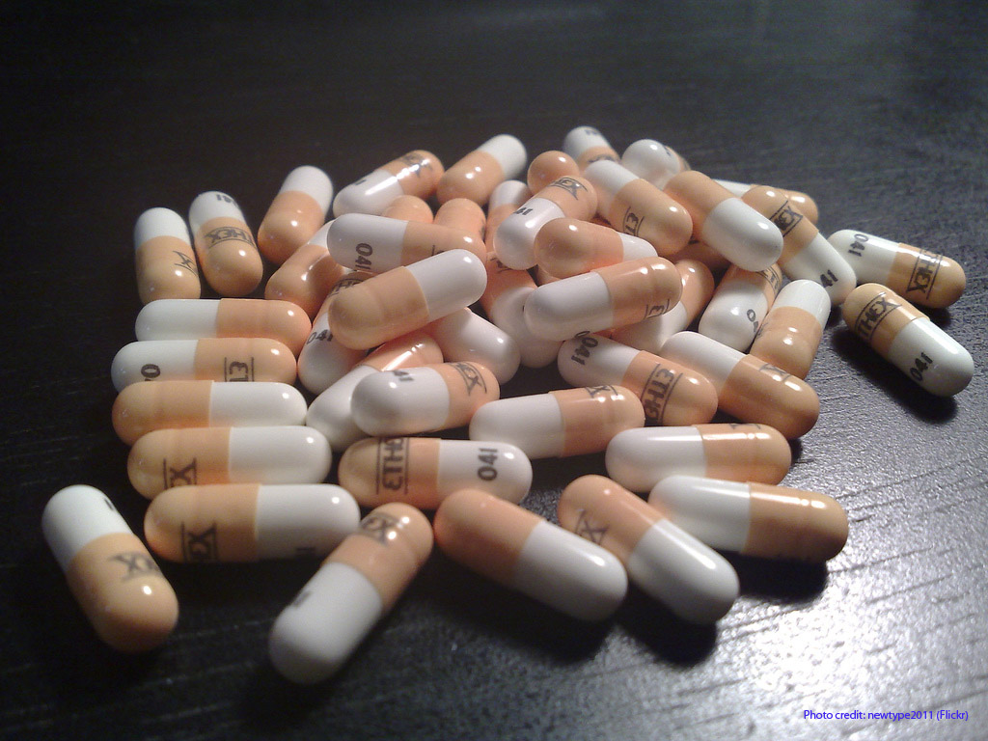
Database Comparison:
DrugBank and
Consumer Health Complete
Christian Burris
LIS 623
March 24, 2010

Slide 2
About DrugBank
Bioinformatics and cheminformatics resource
Highly detailed drug data (chemical, pharmacological and pharmaceutical) along with comprehensive drug target information (sequence, structure, and pathway)
                (source: DrugBank)

Slide 3
About DrugBank (cont.)
4,800 drug entries with 100 data fields
Open source product with 747 sites linked

Slide 4
About Consumer Health Complete
Single most comprehensive resource for consumer-oriented health content
Support patients' information needs and foster an overall understanding of health-related topics
                (source: Consumer Health Complete)

Slide 5
About Consumer Health Complete (cont.)
Approximately 3,267 records
Subscription-based database
HONcode standard compliant

Slide 6
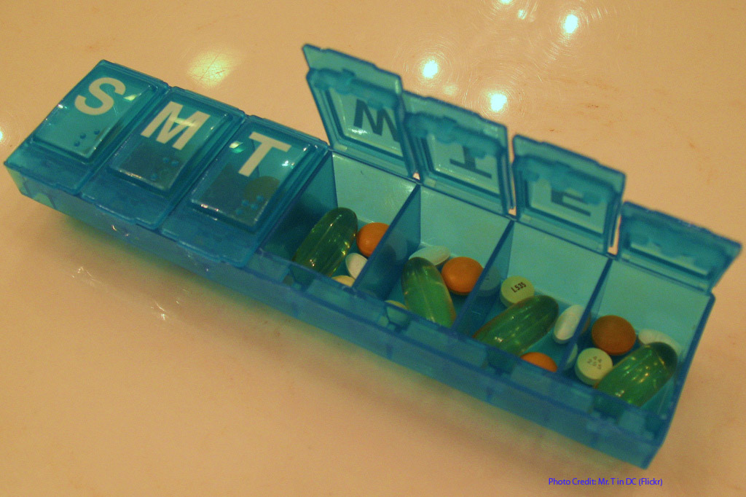
Searching

Slide 7
Searching DrugBank
Search box (Google-like) on every page
Advanced searching: Chem Query, Text Query, Sequence Search, Data Extractor
Browse: sorted by DrugBank ID number or by drug type

Slide 8
Searching Consumer Health Complete
Search under “Drug and Herb Information” on start page
EBSCO database; so Boolean operators and parenthetical searching are possible
“typeahead” feature

Slide 9

Let’s Search!

Slide 10
Accessing…
DrugBank:
  http://www.drugbank.ca/
Consumer Health Complete:
  Databases page of Jackson Library

Slide 11

In summary…

Slide 12
Summary
DrugBank is designed for toward researchers and pharmaceutical study
Consumer Health Complete is designed for casual users and consumer interests

Slide 13

Questions?

